Slide 1
Mood
Tracker

Slide 2
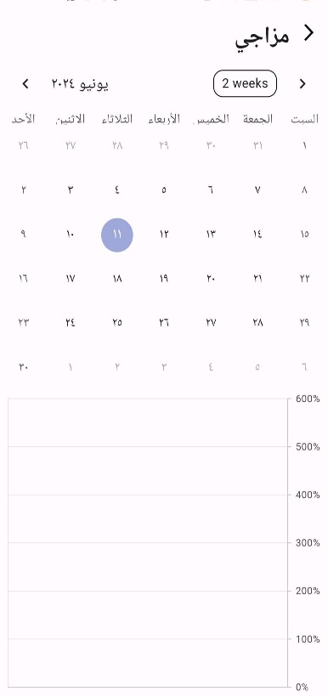
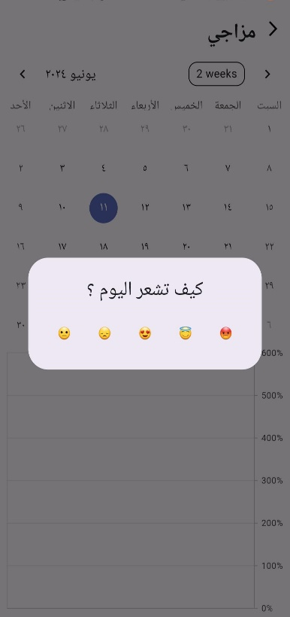
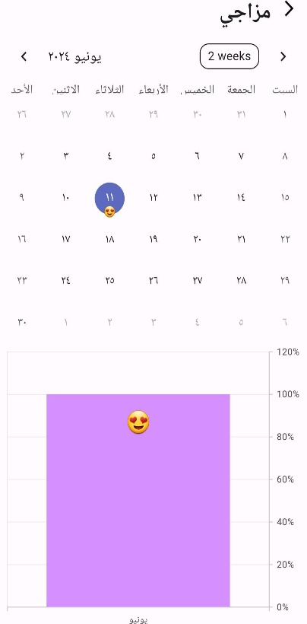
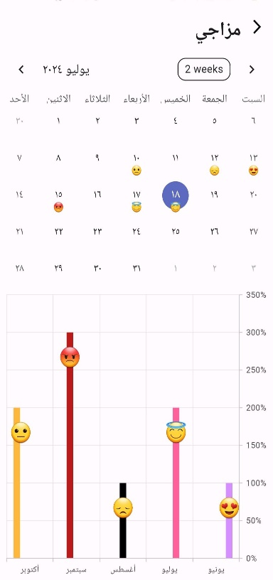
Introduction
This mobile application is designed to track and visualize a user's mood over time. It leverages Firebase for data storage and retrieval, and utilizes various Flutter packages for UI development and functionality. The application is designed specifically for Arabic users, displaying the user interface and calendar in Arabic.
App Functionality
Mood Tracking: The core functionality of the application revolves around mood tracking.
Users can select a mood emoji from a provided selection on a specific calendar date. The application stores the selected emoji for that date.
Mood Visualization: The application presents a visual representation of the user's mood trends over time. It utilizes a SfCartesianChart to display a bar chart, where each bar represents a month. The bar height reflects the most frequent mood emoji selected for that month.

Slide 3
Technical Details
Firebase Integration: The application leverages Firebase for data storage and retrieval. It stores the user's selected mood emoji for each date in a Firestore collection named "mood". The document ID for each document is formatted as "YYYY-MM" (year-month). Each document stores the emojis selected for each day of that month (using the day number as the key) and the overall counts for each emoji throughout the month. Additionally, it stores the Arabic month name and year for reference.
Flutter Packages: The application utilizes various Flutter packages for development. These include:
cloud_firestore: This package facilitates interaction with Firebase Firestore.
firebase_core: This package provides core functionalities for Firebase usage within the Flutter application.
intl: This package is used for internationalization and formatting, including the Arabic calendar display.
shared_preferences: This package enables storing and retrieving data locally on the user's device. In this application, it is used to store the most recently selected emoji for a particular date to optimize data retrieval.
table_calendar: This package provides a customizable calendar widget. The application configures it to display the calendar in Arabic.
syncfusion_flutter_charts: This package is used to create the bar chart that visualizes the mood trends.

